Slide 1

Computer Organization And Architecture
CPEN6260010 (2 Credits)
S2-S3 MARIE-An Introduction to a Simple Computer
Dr. Endra, S.Kom., M.T.
D2395

Slide 2
Learning Outcomes
LO-1: Explain the underlying mathematical and logical principles of various data representations (e.g., integer, floating-point, character codes) used in computer systems.
LO-2: Explain the fundamental structure and operation of the Central Processing Unit (CPU), including the roles and interactions of its main components (e.g., ALU, control unit, registers) during instruction execution.
LO-3: Demonstrate the execution of simple machine instructions, showing the interactions between CPU components and memory.

Slide 3
OUTLINE
CPU Basics: Registers, ALU, Control Unit
The Bus and System Clocks
Memory Organization and Addressing
MARIE's Architecture and Instruction Set
The Fetch-Decode-Execute Cycle
Assemblers and Control Units
Real-World Examples of Computer Architectures

Slide 4
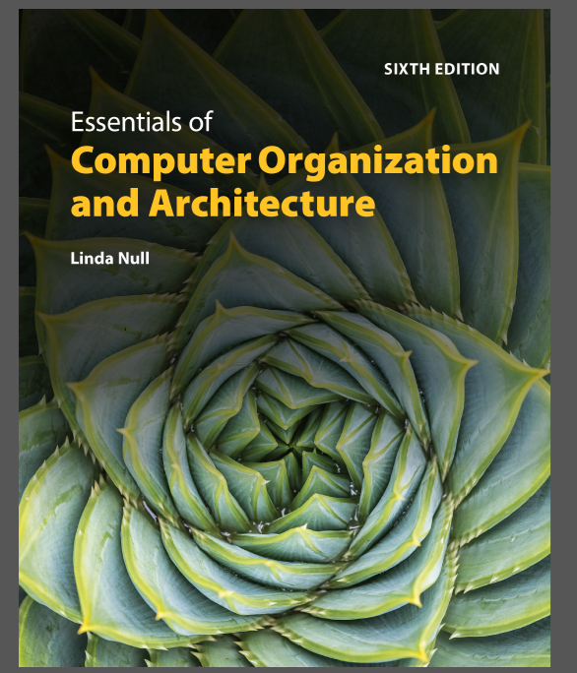
TEXTBOOK
Linda Null. (2023). Essentials of Computer Organization and Architecture with Navigate Advantage Access. Jones & Bartlett Learning. 25 Mall Road Burlington, MA 01803. ISBN: 1284259439.

Slide 5
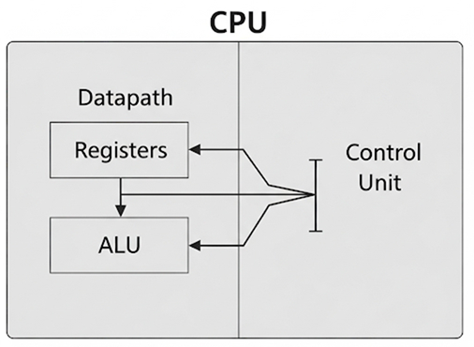
CPU Basics: Registers, ALU, Control Unit
CPU Basics: Datapath & Control Unit
The Central Processing Unit (CPU) is responsible for fetching program instructions, decoding them, and performing the indicated operations on the correct data. The CPU can be divided into two main parts:
The Datapath: A network of registers, ALUs, and internal buses that moves and processes data.
The Control Unit: A 'traffic manager' that monitors instruction execution and ensures the correct data is in the right place at the right time."

Slide 6
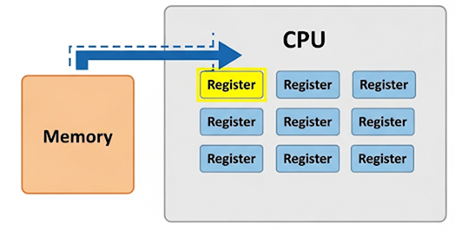
CPU Basics: Registers, ALU, Control Unit
CPU's Scratchpads: The Registers
Registers are hardware devices that store binary data and are the fastest type of memory available. They are located on the processor for very quick access. Registers can contain a wide variety of data, such as addresses, program counters, or data necessary for program execution. Some are special-purpose, like those for holding instruction addresses, while others are general-purpose and can be used by the programmer.

Slide 7
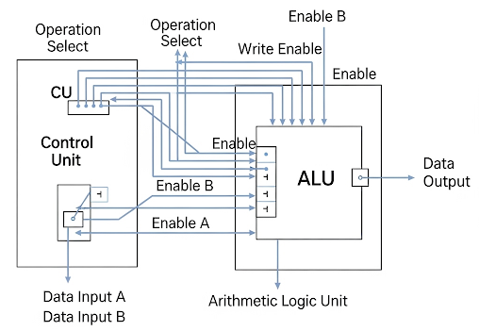
CPU Basics: Registers, ALU, Control Unit
The ALU and Control Unit
The Arithmetic Logic Unit (ALU) carries out the logic operations (like comparisons) and arithmetic operations (like add or multiply) required during program execution. It is controlled by signals from the control unit.
The Control Unit is the 'policeman' of the CPU. It monitors the execution of all instructions, extracts them from memory, decodes them, and tells the ALU and registers what to do to ensure operations are performed correctly.

Slide 8
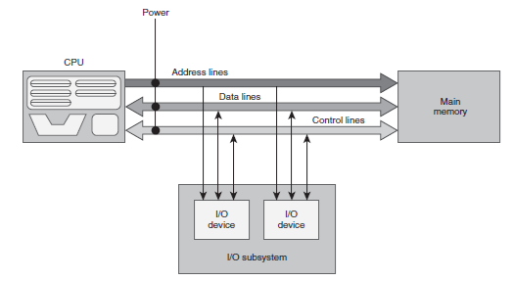
The Bus and System Clocks
The Bus: A Shared Datapath
A bus is a set of wires that acts as a shared but common datapath to connect multiple subsystems within the system. It allows for the parallel movement of bits. A typical bus consists of three types of lines:
Data lines: Carry the actual information to be moved.
Address lines: Indicate the memory or device location for the data.
Control lines: Coordinate the operations, specifying which device can use the bus and for what purpose (e.g., read or write).

Slide 9
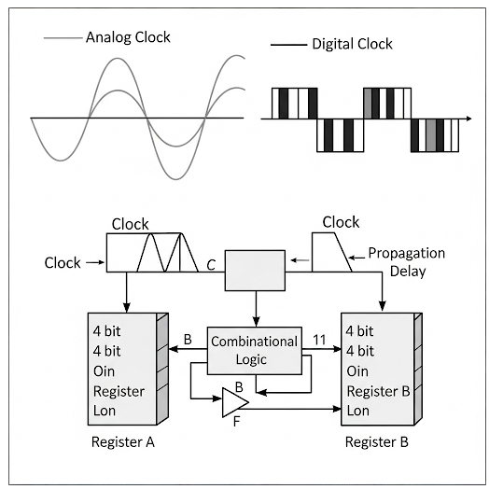
The Bus and System Clocks
Clocks: Synchronizing the System
Every computer contains an internal clock that regulates how quickly instructions can be executed and synchronizes all components in the system. The CPU requires a fixed number of clock ticks to execute each instruction, so instruction performance is often measured in clock cycles.
The clock frequency (or rate) is the reciprocal of the clock cycle time. While a faster clock makes a machine run faster, the clock cycle must be long enough to allow signals to propagate through all circuits to the next set of registers.

Slide 10
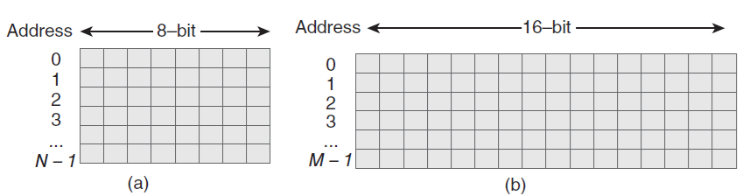


Memory Organization and Addressing
Memory Organization and Addressing
Memory can be envisioned as a matrix of bits where each row, or memory location, has a unique address.
Byte Addressable: Each individual byte in memory has a unique address. This is the most common addressing scheme today.
Word Addressable: Each word (a multi-byte unit) has its own address.
The number of bits required for a memory address is determined by the number of addressable units, not the size of each unit. For a memory with 2^{N} addressable units, N bits are required to address each unit uniquely.

Slide 11
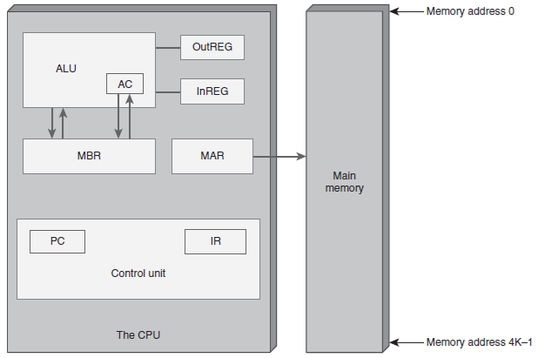
MARIE's Architecture and Instruction Set
MARIE: A Simple, Intuitive Architecture
MARIE = Machine Architecture that is Really Intuitive and Easy
MARIE is a simple but functional architecture designed to illustrate key concepts. It has a single CPU (with an ALU and registers) and memory. Key characteristics include:
It is a stored-program, fixed word length machine.
It has 4K words of main memory, which implies 12 bits per address.
It uses a 16-bit data word and a 16-bit instruction format (4 bits for opcode, 12 for address).
It has a limited set of seven registers.

Slide 12

MARIE's Architecture and Instruction Set
MARIE's Instructions & RTN
MARIE has a simple, yet powerful, instruction set. An Instruction Set Architecture (ISA) specifies the instructions a computer can perform and their format. We use Register Transfer Notation (RTN) as a symbolic way to describe the 'microoperations' that happen at the register level for each instruction. For example, the Load X instruction is not just one step; it involves mini-instructions to move the address into the MAR (Memory Address Register), then the data from memory into the MBR (Memory Buffer Register), and finally into the AC (Accumulator).

Slide 13
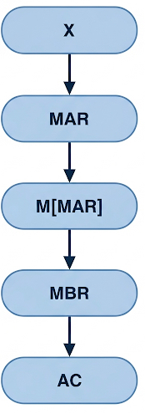
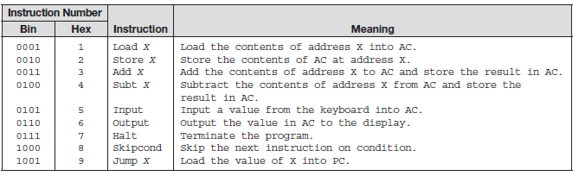
MARIE's Architecture and Instruction Set
MARIE's Instructions & RTN

Slide 14
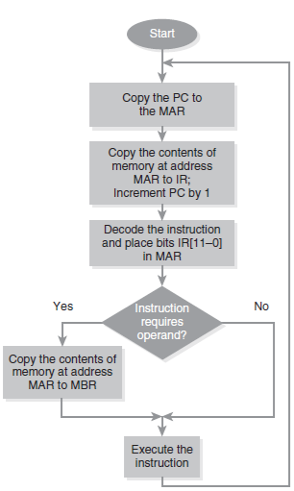
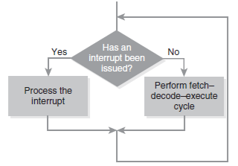

The Fetch-Decode-Execute Cycle
The Fundamental Machine Cycle
All computers follow a basic machine cycle, which represents the steps a computer follows to run a program. The CPU fetches an instruction from memory, decodes it to determine the operation and operands, and then executes it by performing the indicated operation. This cycle is the foundation of all computation. An important note: at the beginning of each cycle, the CPU checks to see if an interrupt has been issued, which is an event that alters the normal flow of execution.

Slide 15
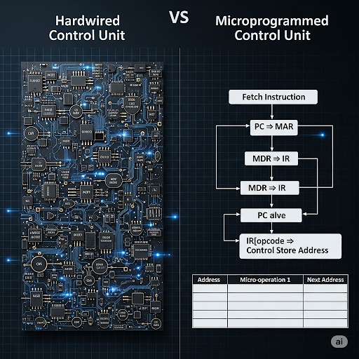
Assemblers and Control Units
From Language to Hardware
An assembler is a program that converts assembly language (symbolic mnemonics) into machine language (binary values). The control unit, driven by the processor's clock, is responsible for decoding this machine code and creating the necessary control signals to make the hardware work. There are two ways to implement a control unit:
1. Hardwired Control: Uses fixed combinational logic gates, making it very fast but difficult to design and modify.
2. Microprogrammed Control: Employs software (microcode) to carry out instructions, making it more flexible but typically slower.

Slide 16
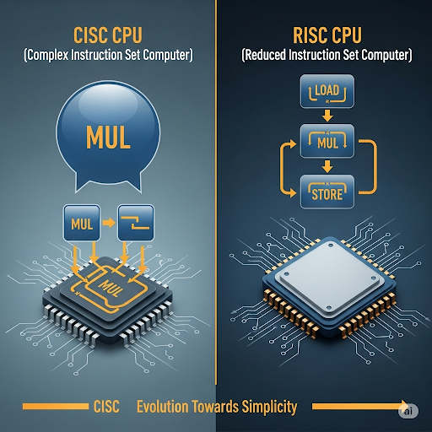
Real-World Examples of Computer Architectures
Real-World Architectures: CISC vs. RISC
While MARIE is a simple model, real-world architectures are more complex. Two major philosophies exist:
CISC (Complex Instruction Set Computer): A large number of instructions of variable length and complexity. A single instruction can perform multiple operations. The Intel x86 family is a prime example.
RISC (Reduced Instruction Set Computer): A small set of simple, fixed-length instructions. Each instruction performs a single operation. This approach allows for faster execution per instruction. MIPS and ARM are examples of RISC machines.

Slide 17
Evaluation
Session 2-3 Exercises
How is the ALU related to the CPU? What are its main functions?
How many bits would you need to address a 2M×32 memory if the memory is word addressable?
Explain why, in MARIE, the MAR is only 12 bits wide and the AC is 16 bits wide. (Hint: Consider the difference between data and addresses.)
List the hexadecimal code for the program given in the next page.
Explain the difference between hardwired control and microprogrammed control.
Compare CISC machines to RISC machines.

Slide 18
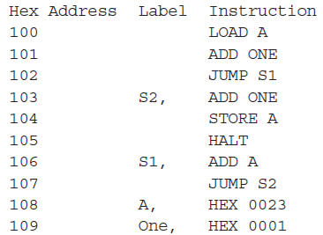
Evaluation
Session 2-3 Exercises
Program for Exercise No.4:

Slide 19
Reference
Linda Null. (2023). Essentials of Computer Organization and Architecture with Navigate Advantage Access. Chapter 4: MARIE-An Introduction to a Simple Computer. 25 Mall Road Burlington, MA 01803. ISBN: 1284259439.

Slide 20


